Slide 1
Data Bases and Data Types
DL Day 3 class

Slide 2
Learning Objectives
By the end of this lesson, you will be able to:
Define the concept of a database and how it is used to store data
Identify the core components of a relational database table
Explain basic database terminology like rows, columns, tables, and relationships
Define data types.

Slide 3
Learning Objectives
Being skilled with databases enables analysts to:
Retrieve, combine, prepare data needed for analytical projects drawing out insights
Identify connections between datasets to enrich analysis
Self-service analytics
Having strong database familiarity lets analysts gather, investigate and prepare data with flexibility and precision.

Slide 4
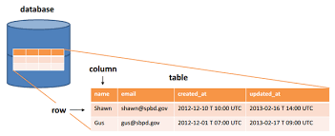
Databases
A database is an organized collection of data stored and accessed electronically from a computer system.
Databases allow users to easily store, update, retrieve, and manage large amounts of information in a structured and organized way.

Slide 5
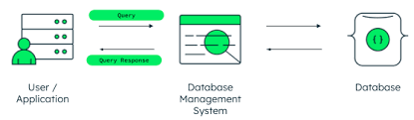
Databases
Some key concepts related to databases:
Database Management Systems (DBMS): Software used to create, access, manage, search, and analyze the data in a database.
Popular DBMS options include MySQL, Oracle, Microsoft SQL Server, and MongoDB.

Slide 6
Databases
Tables: Databases organize information into tables that store data in rows and columns. For example, a "Customers" table might have columns like "Name," "Address," and "Phone Number" and each row would represent an individual customer.
Records: A record, also called a row, is each individual entry stored in a table, like a customer or product. It is a collection of related data across the various fields.
Fields: The columns in a database table are called fields or attributes. Fields represent a characteristic or attribute of the larger entries, like a name or date.

Slide 7
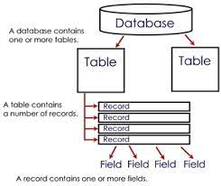
Databases

Slide 8
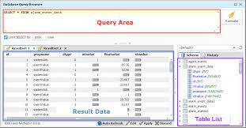
Databases
Queries: A database query is a request for specific information from a database. It allows for powerful analysis and filtering.

Slide 9
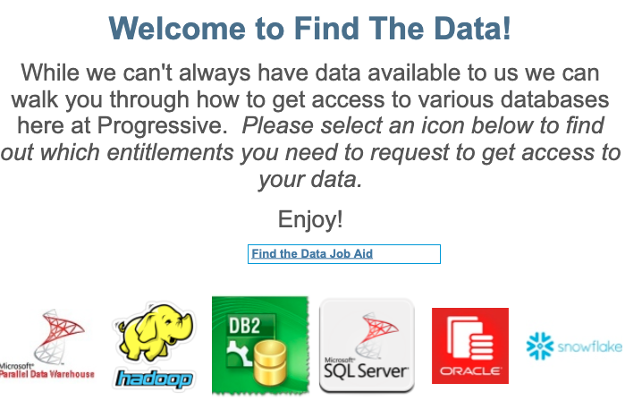
Databases
Databases At Progressive: Findthedata/
https://tableauserver/t/PersonalLines/views/FindTheData/Home?%3Aembed=y&%3AshowShareOptions=true&%3Adisplay_count=no&%3AshowVizHome=no#1

Slide 10
Relational Databases
Relational databases organize structured data into tables that can be easily managed, accessed, manipulated and linked through SQL without needing to rewrite or reorganize underlying data.
This model provides flexibility, simplicity and performance.
Flexibility:
Relational databases are flexible because the tabular storage allows
New data categories
Fields
Tables to be added easily without needing to make changes to existing structures

Slide 11
Relational Databases
Simplicity:
The tabular, row and column structure of relational data is intuitive and easy to understand for users familiar with spreadsheets.
SQL provides simple, declarative statements for most database operations hiding away the underlying database complexities.
Performance:
Tables allow for efficient storage and access of data due to their structured organization
Relational databases are designed to optimize query performance through features like joins, partitioning.

Slide 12
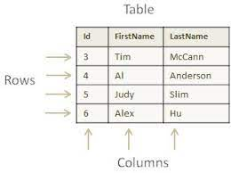
Relational Databases
Store structured, tabular data
Data is stored in two-dimensional database tables with rows and columns
Tables resemble spreadsheets with cell-based layout
Each row in a table represents a distinct record
Columns define different fields or attributes for the type of records within the table

Slide 13
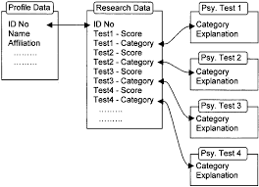
Relational Databases
Tables organize data into fields and records that are interconnected
Fields (columns) contain attributes of a record like name, age etc.
Records (rows) represent individual data entries like a customer, product etc.
Structured relationships between tables connect records across tables

Slide 14
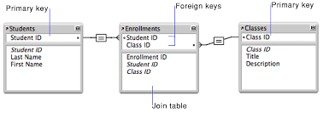
Relational Databases
Key constraints define table relationships
Primary key uniquely identifies each record in a table
Foreign keys establish links between records in different tables
Constraints enforce referential integrity between linked tables

Slide 15
Relational Databases
This storage approach allows relational databases to consolidate data into normalized structures while preserving organized relationships between elements enabling simple, performance data storage and retrieval.
By structuring data into optimized, uniform tables, then establishing defined connections across tables, relational database model allows:
Simpler schema design
Reduced data duplication
Ensures consistency while giving users and applications standardized access to efficiently managed data.

Slide 16
Table Data Structures
Database tables have a structured tabular format for organizing and storing data in an efficient and consistent manner.
Data types are an important structural aspect of database tables that help define what type of data can be stored in a column.
Rather than allowing arbitrary data entry, data types constrain values to pre-defined formats.

Slide 17
Table Data Structures
For example:
A data type of TEXT allows letters, numbers, and special characters to be stored.
While NUMBER or INTEGER types require numerical values.
Other types like DATE ensures only properly formatted date values can be added.
Designating an AGE column to only accept integers enforces consistency in the values.

Slide 18
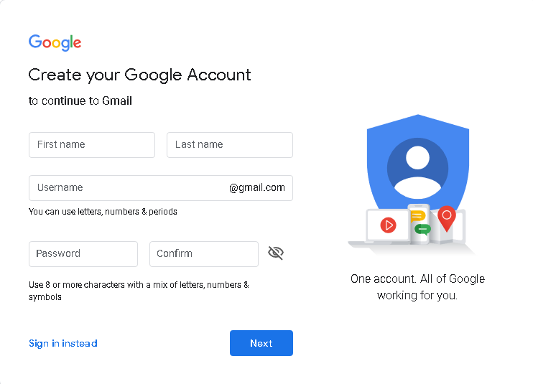
Table Data Structures
To understand SQL Server data types, let’s look at the following page to create a new Google account (for reference purpose only):

Slide 19
Table Data Structures
It requires the following inputs:
First name and Last name: Suppose we require only alphabets in these fields
Username: We can use letter, numbers and periods in the user name
Password: We can use alphabets, numbers, and special characters
We store all these columns data in a table of a Database Server. We can use various data types in Databases and use them as per the requirement.

Slide 20
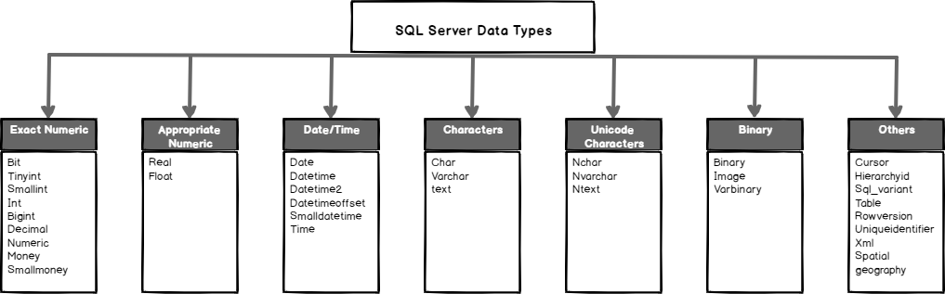
Table Data Structures
Categories of Databases Data Types

Slide 21
Table Data Structures
Categories of Databases Data Types
Exact numeric: bit, tinyint, smallint, int, bigint, decimal, numeric, money and smallmoney
Approximate numeric: Float
Date and time: date, DateTime, datetime2, datetimeoffset, smalldatetime, time
Character strings:char, varchar, text
Unicode character strings: Nchar, Nvarchar, Ntext
Binary strings: Binary, image and varbinary

Slide 22
Table Data Structures
Exact numeric SQL Server data type
We use exact numeric data types for integer, decimal, and money.
Each data type has its own lower, upper limit and memory requirements.
We should use the smallest data type to save memory requirements as well.
For example, we can use the bit data type for storing true (1) or false (0) values.

Slide 23
Table Data Structures
Exact numeric Data type
Data Type | Lower Range | Upper Range | Storage | Remarks
Bit | 0 | 1 | 1 byte | We can also store NULL values in this.
Int | −2^31 (−2,147, 483,648) | 2^31−1 (−2,147, 483,647 | 4 bytes | It also stores the whole number similar to a smallint but its lower and upper limits changes as defined.
Decimal | −10^38+1 | 10^381−1 | It depends upon precision. 1 – 9 -> 5 bytes 10-19->9 bytes 20-28->13 bytes 29-28->17 bytes | We use decimal data type for scale and fixed precision numbers.
Numeric | −10^38+1 | 10^381−1 | It depends upon precision. 1 – 9 -> 5 bytes 10-19->9 bytes 20-28->13 bytes 29-28->17 bytes | Decimal and numeric are synonyms. We can use them interchangeably.
Smallmoney | -214,478.3648 | +214,478.3647 | 4 bytes | We can use this data type for monetary or currency values.
Money | −922,337, 203, 685,477.5808 | +922,337, 203, 685,477.5807 | 8 bytes

Slide 24
Table Data Structures
Approximate numeric SQL Server data type
Data Type | Lower Range | Upper Range | Storage | Remarks
Real | −3.40E+38 | 3.40E+38 | 4 bytes | We can use float924) as ISO synonym for real.
Float(n) | −1.79E+308 | 1.79E+308 | Its storage depends upon value (n) N(1-24) ->4 bytes N(25-53)->8 bytes | It is an Approximate-number data types. The default value of N is 53.

Slide 25
Table Data Structures
Date and Time Data types
We stored date and time data along with time offset using these data types.
Data Type | Lower Range | Upper Range | Storage | Remarks
Date | 0001-01-01 | 9999-12-31 | 3 bytes | 1. It stores only dates in SQL Server. 2. Its default value is 1900-01-01. 3. It provides default format YYYY-MM-DD.
Datetime | 1753-01-01 | 9999-12-31 | 8 bytes | 1. We can define a date along with time with fractional seconds. 2. The default value for this data type is 1900-01-01 00:00:00. 3.It provides accuracy in increments of .000, .003, or .007 seconds. 4. We should avoid using this data type. We can use Datetime2 instead.
Datetime2 | 0001-01-01 00:00:00 | 9999-12-31 23:59:59.9999999 | 6-8 bytes 1. Precision<3 -> 6 bytes 2.Precision 3 or 4-> 7 bytes | 1. the default format for this is YYYY-MM-DD hh:mm: ss[.fractional seconds]. 2. It provides precision from 0 to 7 digits, with an accuracy of 100ns. 2. The default precision for datetime2 is 7 digits.
Time | 00:00:00.0000000 | 23:59:59.9999999 | 5 bytes | 1. We can use it for storing only time data. 2. Its default format is hh:mm:ss[.nnnnnnn]. 3. It provides an accuracy of 100 nanoseconds

Slide 26
Table Data Structures
Character Strings Data types
Data Type | Lower Range | Upper Range | Storage | Remarks
Char(n) | 0 characters | 8000 characters | N bytes | 1. It provides a fixed-width character data type.
Varchar(n) | 0 characters | 8000 characters | n bytes + 2 bytes | 1.It is a variable length character data type. 2.N defines the string size.
Varchar (max) | 0 characters | 2^31 chars | n bytes + 2 bytes ~ 2 GB | We should avoid using this data type unless required due to its huge storage requirement.
Text | 0 chars | 2,147,483,647 chars | n bytes + 4 bytes | 1. It is a variable-length character data type. 2. We should avoid using this data type as it might get deprecated in future versions of SQL Server.

Slide 27
Table Data Structures
Unicode character string Data types
Data Type | Lower Range | Upper Range | Storage | Remarks
Nchar | 0 characters | 4000 characters | 2 times n bytes | It is a Unicode string of fixed width.
Nvarchar | 0 chars | 4000 Chars | 2 times n bytes | Nvarchar is a Unicode string of variable width.

Slide 28
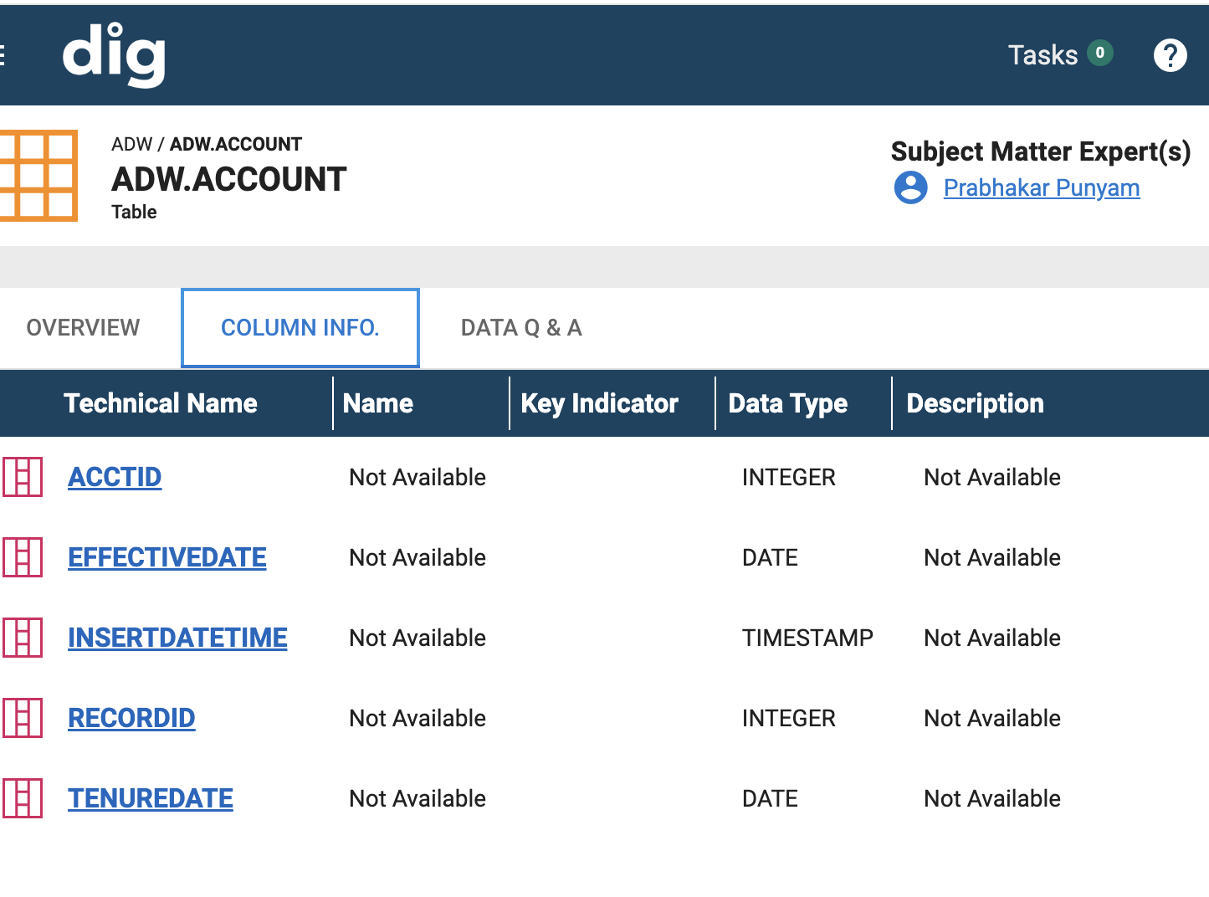
Table Data Structures
Using DIG to begin your data journey
Type DIG/ into your browser
take a look at some of the databases
Review the tables and columns
Identify the types

Slide 29
Query
A query is a request made to a database to retrieve specific data that meets certain criteria.
Some key points about database queries:
A query allows selective retrieval of data from a database rather than retrieving all records at once.
Queries are constructed using query languages like SQL with syntax specifying what data to retrieve and filter on.
The most common SQL queries are SELECT statements which define the table columns to show and the conditions rows must meet using WHERE clauses.

Slide 30
Query
Query criteria can filter on text matches, numeric & date ranges, associations between tables to derive relevant information.
Queries help answer specific business questions like "What products had the most sales last month?" without needing manual analysis.
Results can be sorted, aggregated (summaries), and segmented as needed for reporting or analysis.
Parameters can be used to make dynamic queries that change based on user inputs.

Slide 31
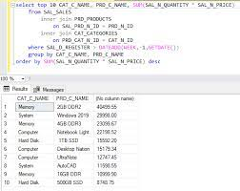
Query
In summary, database queries allow users to selectively retrieve the most relevant data for their needs from among large datasets in an efficient manner.
They underlie analytics, business intelligence and many database applications.

Slide 32
Summary
Key Points
Databases provide electronic storage and data management via optimized table structures and sophisticated database management systems for reliably scaling data.
Relational databases organize data into tables with formal connections between them to model real-world entities and relationships. This provides simplicity and performance.
Tables consisting of rows, columns and keys give a standardized structure combined with the flexibility to adapt for future needs through constraints, normalizations etc.
SQL queries allow selectively filtering and aggregating data to derive insights efficiently without manual effort even from billions of rows due to the deliberate underlying database designs.

Slide 33
Summary
From storing to accessing data, databases emphasize formalized tables and queries as specialized structures engineered for the era of data-driven decisions. This model balances optimal speed, scale and integrity demands allowing modern applications to leverage data systematically

Slide 34
Exercises
Entity Relationship Diagram Design
Break into small teams. Give each a business scenario and have them draw out entities, attributes, relationships to model database schema through an ERD.
Normalization Practice
Provide sample non-normalized data set to teams. Have them normalize it to appropriate consistency form.
Query Formulation
Offer some sample problem statements/business questions. Teams write SQL queries to retrieve requested data. Compare different query strategies.
Database Optimization
Set up simple database environment. Have teams identify bottlenecks like long read/writes, redundant/inconsistent data based on usage. Perform corrections.

Slide 35
Exercises
Use Case Conceptualization
Teams come up with ideas to leverage databases for various scenarios: ecommerce, banking, supply-chain etc. Present possibilities and limitations.
Database Administration Exercise
Give sandbox access to practice tasks like user provisioning, backup, restoration, high availability.
The core themes would be strengthening both conceptual (ERD, use cases) and technical (queries, optimization) hands-on skills while encouraging collaborative thinking for analyzing needs, problem resolution and evaluation of tradeoffs. Tie learning to real-world applicability.

